Slide 1
THE MOST ECONOMICAL WAY TO TURN MANURE INTO COMPOST
tim@dungstercomposting.com
www.dungstercomposting.com

Slide 2
Part 2, Composting Manure, Hygiene, Health & Ecology +Compliance: a little-known secret
dungstercomposting.com

Slide 3
Bio of Tim Shuttleworth
Retired (twice) from global manufacturing career, 18 years as the CEO
Grew-up on an Indiana chicken farm, youngest of 8 kids
Father grew tomatoes and ran a tomato cannery (1911 - 1961)
Step-father trained race-horses (sulky trotters and pacers)
Earned a Certificate in Environmental Studies (1981)
Earned an MBA from University of Notre Dame with Honors (1988)
Compulsive recycler and inventor (6 patents)
Married 41 years, 5 married kids, 9 grandkids and counting…
dungstercomposting.com

Slide 4
Economics, Hygiene, Health & Ecology
Recap on the Economics:
Compost market prices are reported by
Composting News. Additionally, many
producers have prices on their websites.
Prices range from $20 to $60/cubic yard
Purchased Dungster Composters have less
than a 3-year payback period (new
Equipment, if used then shorter).
If rented, rental fees are covered
by compost sales and
labor saved.
DONE!
Bonus:
Economy of Effort
dungstercomposting.com

Slide 5
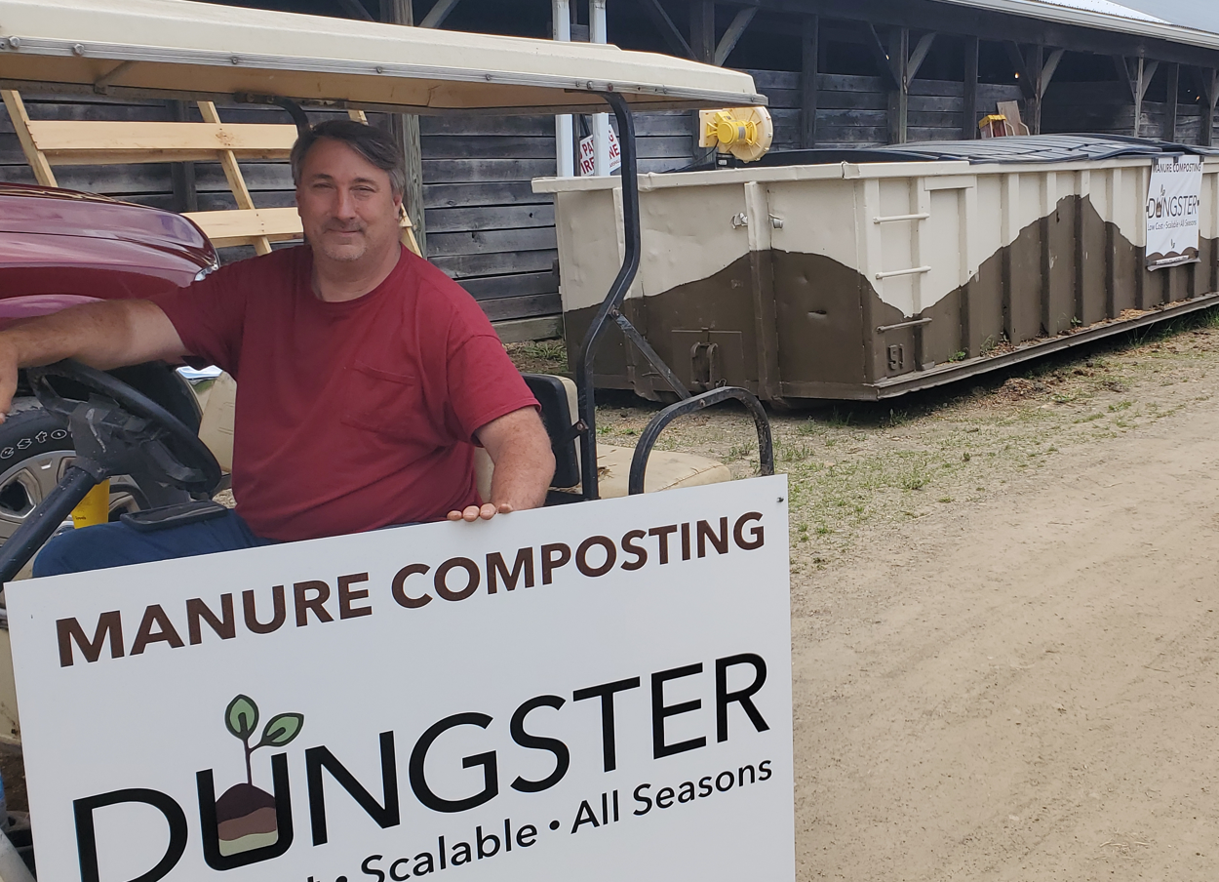
Vince and Pam challenged me
to create an easier loading method.
Bonus:
Economy of Effort

Slide 6
What is worth more than money?
Family
Our health
Our community
Our animal’s health
Our Country’s clean air & water
Composting serves all these values
dungstercomposting.com

Slide 7
Source:

Slide 8
Panel: Equestrian Community’s Impact on Global, Environmental, and Social Issues presented by MARS EQUESTRIAN by US Equestrian Communications Department | Jan 9, 2020, 11:11 PM EST
This panel reported…
“A key issue that remains prevalent within the equestrian community is the disposal of equine waste and how to make the process of equine waste disposal more sustainable.”
… and…
“Sustainable manure removal and disposal has been a hot topic within the industry for years, and the development of new technologies and systems has been slow to catch up with demand.”
Source: Panel: Equestrian Community’s Impact on Global, Environmental, and Social Issues presented by MARS EQUESTRIAN | US Equestrian (usef.org)

Slide 9
Important composting technical terms:
Aerobic vs Anaerobic
…having oxygen (aerobic) or not having oxygen (anaerobic.)
= Aerobic =hot
Thermophilic
…an organism that thrives at relatively high temperatures, between 41 and 122 °C (106 and 252 °F). They can be bacteria or fungi.
Eutrophication
…excessive richness of nutrients in a lake or other body of water, frequently due to runoff from the land.
In-vessel composting - Wikipedia
…air flow and temperature can be controlled,
using the principles of a "bioreactor".
dungstercomposting.com

Slide 10
Why Dungster uses “In-vessel” Composting?
Source: Page 72, “Compost Operator Manual” by John Paul of BC Canada
Why use in-vessel composting?

Slide 11
Composting, non-monetary benefits
Mitigating air and water pollution
Disease management
Odor and Fly Control
Weed Control
Aesthetics
Methane, or CH4, is the second most damaging greenhouse gas.
CH4 is 20 times more potent GHG than CO2.
Why it matters:
Aerobic composting produces CO2
Anaerobic composting produces CH4
dungstercomposting.com

Slide 12
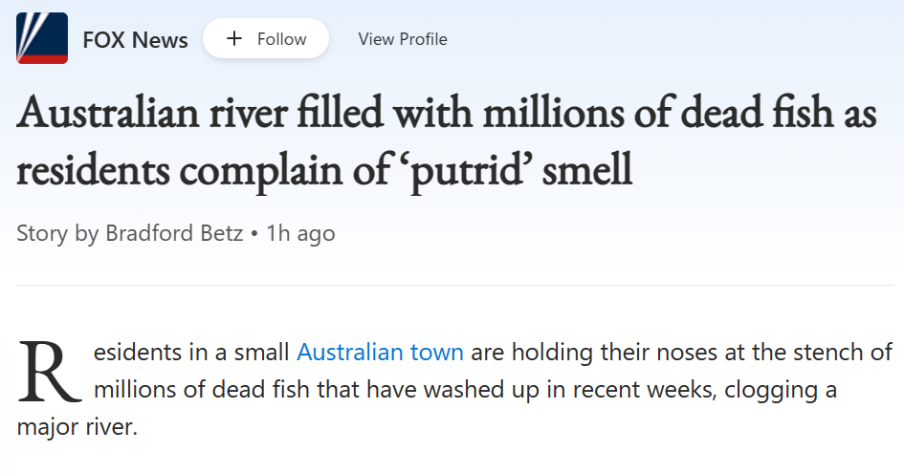
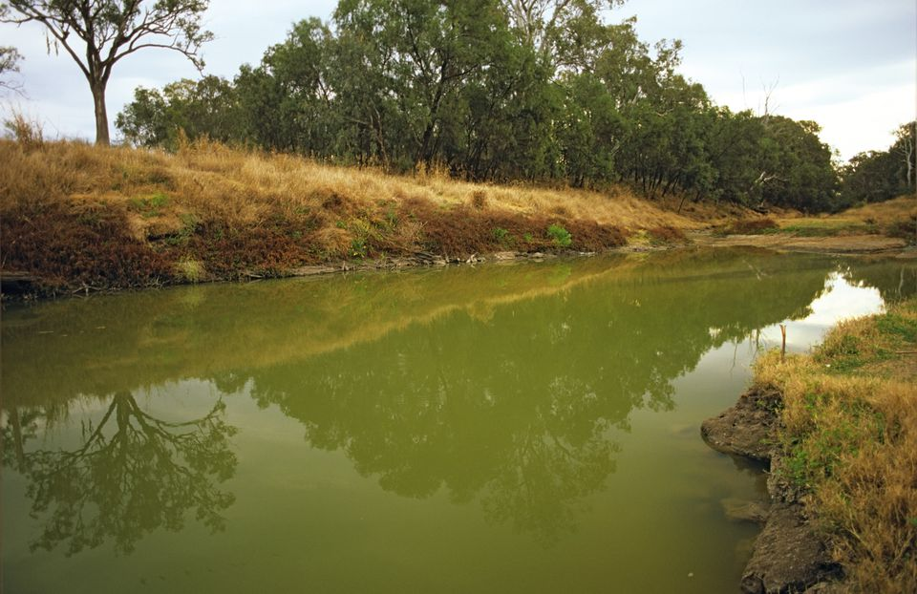
Composting, non-monetary benefits
Mitigating air and water pollution
Disease management
Odor and fly control
Weed control
Aesthetics
Algae blooms
Why it matters:
Dead Zones in the Gulf of Mexico
Red tide on the Florida coast
Toxic algae in Lake Erie
Death of 1,000 manatees in Florida
This environmental issue is not unique to America
dungstercomposting.com

Slide 13
Composting, non-monetary benefits
Mitigating air and water pollution
Disease management
Odor and fly control
Weed Control
Aesthetics
Why it matters:
High temperatures destroy parasites
and breaks their reproduction cycle mitigating
worm counts.
Aerobic
= HOT!
Worm eggs and larvae do not survive Aerobic Temps temperatures
dungstercomposting.com

Slide 14
Composting, non-monetary benefits
Mitigating air and water pollution
Disease management
Odor and fly control
Weed Control
Aesthetics
Aerobic vs
Anaerobic
1) Odorous composting usually has anaerobic conditions occurring producing methane and odorous ammonia gases. Well aerated piles do not emit odors.
2) Fly control, same as with disease management, hot composting destroys fly eggs and larvae.
dungstercomposting.com

Slide 15
Composting, non-monetary benefits
Mitigating air and water pollution
Disease management
Odor and fly Control
Weed Control
Aesthetics
Hot composting renders weed seeds unable to germinate.
This in turn lessens the use of chemical herbicides where the compost is applied.
Aerobic
= HOT!
dungstercomposting.com

Slide 16
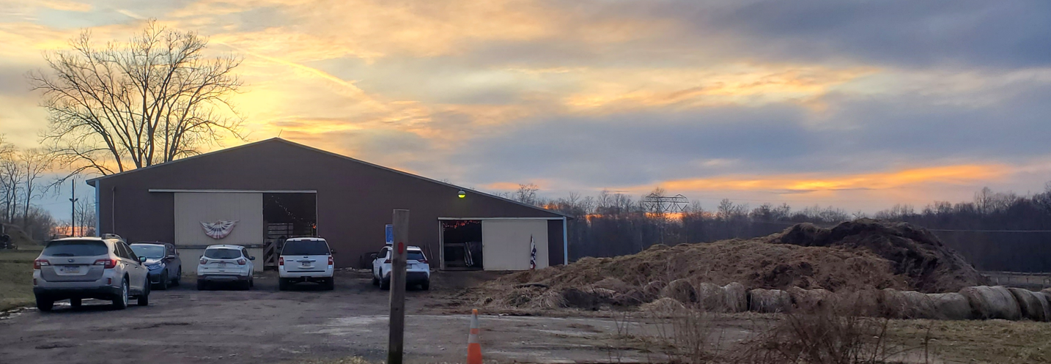
Composting, non-monetary benefits
Mitigating air and water pollution
Disease management
Odor and fly Control
Weed Control
Aesthetics
Five client cars parked adjacent to the main manure pile.
If not tuned regularly this will be odorous and a source of fly hatching outbreaks. How can that pile now be turned?
dungstercomposting.com

Slide 17
A magic of compost
Water Management
Compost retains moisture like a sponge.
Compost is to soil as a flywheel is to an engine.
Heavy rains are less destructive.
Droughts will be less severe.
dungstercomposting.com

Slide 18
Four Key Take-aways Non-economic benefits
Composting manure does no harm! Just the opposite including:
Conservation of nurtriates in our soils for plant growth and not in out Waterways.
Conservation of water and water absorption when in excess.
Not composting can allow harms to occur, such as:
Water and air pollution
Parasite life-cycle, growth and elevated worm counts.
Odor and fly hatch nuisance events
Improves the aesthetics of the boarding operation
When done correctly, following the O.H.I.O. principle, it will
Lessen the human workload.
4. Composting, the only financial and ecological manure solution.
Only Handle It Once
Bonus: Economy of Effort
dungstercomposting.com

